Slide 1

DEPARTMENT OF
ELECTRONICS AND COMMUNICATION ENGINEERING
ELECTRONIC DESIGN WORKSHOP – U20ECP612
SMART DRIVER MONITORING SYSTEM
SUPERVISED BY
Dr.R.KURINJIMALAR
Professor/ECE
TEAM MEMBERS
BHAVANA S - 21UEC028
DHARSHINI R - 21UEC040
MIRDHU MALYA K I - 21UEC121

Slide 2
CONTENTS
Objective
Introduction
Problem Statement
Literature Survey
Proposed System
Result and Discussion
Conclusion
Future work
Reference

Slide 3
OBJECTIVE
In modern society, road safety is a paramount concern, with millions of lives at stake worldwide due to accidents caused by driver fatigue and inattention. Driver drowsiness, in particular, poses a significant risk on the roads, leading to a substantial number of accidents each year. In response to this pressing issue, our project endeavours to develop a proactive solution aimed at detecting and mitigating the risks associated with driver drowsiness in real-time.The project focuses on the integration of advanced sensor technologies, microcontroller-based control systems, and intelligent alert mechanisms to create a robust driver drowsiness detection system for vehicles. By leveraging the capabilities of sensors such as the eye-blink sensor and GPS module, coupled with the processing power of the Arduino Nano microcontroller, our system aims to provide an effective and reliable means of preventing accidents caused by driver fatigue.The primary objective of the project is to develop a comprehensive solution capable of accurately detecting signs of driver drowsiness and initiating appropriate safety measures to ensure the well-being of vehicle occupants and other road users. To achieve this goal, the project encompasses several key components and functionalities, each playing a crucial role in the overall system architecture and operation.

Slide 4
INTRODUCTION
Central to the system's functionality is the eye-blink sensor, which serves as the primary means of detecting driver drowsiness by monitoring eyelid movement and blink frequency. When the sensor detects patterns indicative of drowsiness, it triggers the activation of alert mechanisms, including a buzzer to alert the driver and a relay to cut off the vehicle's motor, bringing it to a safe stop.
Furthermore, the integration of a GPS module enables the transmission of the vehicle's location to the owner or relevant authorities in real-time, providing crucial information for prompt assistance and intervention in emergency situations. This feature enhances the overall effectiveness of the system by facilitating rapid response and ensuring timely assistance in critical scenarios.
Through a combination of hardware integration, software development, and rigorous testing, our project aims to assess the feasibility, reliability, and practicality of the proposed driver drowsiness detection system in real-world driving conditions. By addressing the root causes of accidents related to driver fatigue, we aspire to make a meaningful contribution to road safety initiatives, ultimately saving lives and preventing injuries on our roads.

Slide 5
PROBLEM STATEMENT
Accurate detection of driver drowsiness in real-time using non-invasive sensor technologies, to ensure timely alerts and interventions is not easily possible. Seamless integration of the drowsiness detection system with existing vehicle systems, such as the motor control and GPS, to ensure smooth operation and minimal disruption to the driver is one of the major issue .
No proper optimization of the power consumption in the detection system that would avoid draining the vehicle's battery, especially during long trips. The design of the system has to be user-friendly and acceptable to drivers, ensuring it does not intrude excessively into their driving experience or cause discomfort.
The problem statements are as follow below:
1. Accurate Detection of Drowsiness
2. Integration with Vehicle Systems
3. Power Efficiency
4. User Acceptance and Comfort

Slide 6
LITERATURE SURVEY
S.No | Title | Authors | Key Areas | Relevance to Project
1. | Smart Driver Monitoring System with Emergency Response Mechanism | Low Yi Joe,Noel Pang Wg Koh,Kai Yi Celine Goh Lik (2023) | Internet Of Things, Continuous monitoring | Highlights the importance of real time and continuous tracking.
2. | Driver Drwosiness Detection Systems and Applied Technologies | Ansh Gupta,Abhinav Tiwari,Atul Singh,Sachi Gupta (2024) | Convolutional Neural Networks, Photo datasets sampled | Emphasizes the use of pre recorded samples which is used for accurate detection.
3. | Early Identification and Detection of Driver Drowsiness by Hybrid Machine Learning | Ayman Altameem,Ankit Kumar,Ramesh Chandra Poonia,Sandeep Kumar (2021) | Real-time image segmentation, Machine learning technologies | Deals with real-time monitoring and detection of eye movements and facial expressions.

Slide 7
S.No | Title | Authors | Key Areas | Relevance to Project
4. | AI-Driven Driver Behavior Assesment Through Vehicle and Health Monitoring for Safe Driving | S.Yaqoob,G.Morabio, S.Cafiso, G.Pappalardo and A.Ullah (2024) | AI-based Image processing,signal processing, traditional algorithmic approaches | Detects the unusual and different behaviours of the driver while driving and monitoring continuously.
5. | Vehicle Monitoring By Radar | A.Gharamohamadi, A.Khajepour and G.Shaker (2023) | Radar Technology, vehicle sensing, system level design | Emphasizes optimizing safety systems and hands free control.
6. | Design and Development of Smart Driver Safety System using the Behavioural and Physiological Data Approach | D. Varadam and K.V.Ganesh (2021) | Automotive system,collision avoidance,GPS receiver | Includes GPS location transmits as an alert mechanism after drowsiness detection.

Slide 8
PROPOSED SYSTEM
A smart driver monitoring system is an innovative solution designed to enhance vehicle safety by monitoring driver behavior in real-time. This system incorporates various hardware components, including an eye-blink sensor, Arduino Nano microcontroller, relay, buzzer, GPS module, and battery pack, to create a comprehensive monitoring and alert system.
Connect the eye-blink sensor to the Arduino Nano microcontroller using shielded cables or wires. Ensure proper connections to enable reliable data transmission.Power the Arduino Nano microcontroller using the vehicle's electrical system or an external power source. Ensure a stable power supply to maintain continuous operation.
Connect the relay to the Arduino Nano using digital output pins. Configure the relay to control external devices, such as the buzzer, based on input from the microcontroller.Integrate the buzzer and GPS module into the system as output components. Connect the buzzer to the relay for audible alerts and the GPS module to enable location tracking.
Design the architecture of the driver monitoring system, outlining the connections and interactions between the hardware components. Determine how the components will communicate with each other and how the system will respond to different inputs.

Slide 9
SYSTEM OPERATION
Integration and Installation: Careful integration of system components into the vehicle's interior is essential to ensure optimal functionality and user experience. Components such as the eye-blink sensor, buzzer, relay, and Arduino Nano should be strategically positioned within the dashboard area or near the driver's seat for easy access and visibility.
Power Management: Efficient power management is critical to ensure the longevity and reliability of the system's operation. Components should be powered by the vehicle's electrical system or an independent power source, such as a battery pack, with appropriate voltage and current ratings.
Calibration and Tuning: Calibration procedures are necessary to optimize the performance and accuracy of sensor readings under varying environmental conditions. Parameters such as sensor sensitivity, threshold values, and alert triggers may need to be adjusted and fine-tuned to suit individual driver characteristics and driving conditions.
User Interface and Feedback: The user interface plays a vital role in facilitating driver interaction and communication with the system. Visual indicators, such as LED lights or display messages, should provide clear and intuitive feedback on the system's status, alert activations, and diagnostic information.

Slide 10
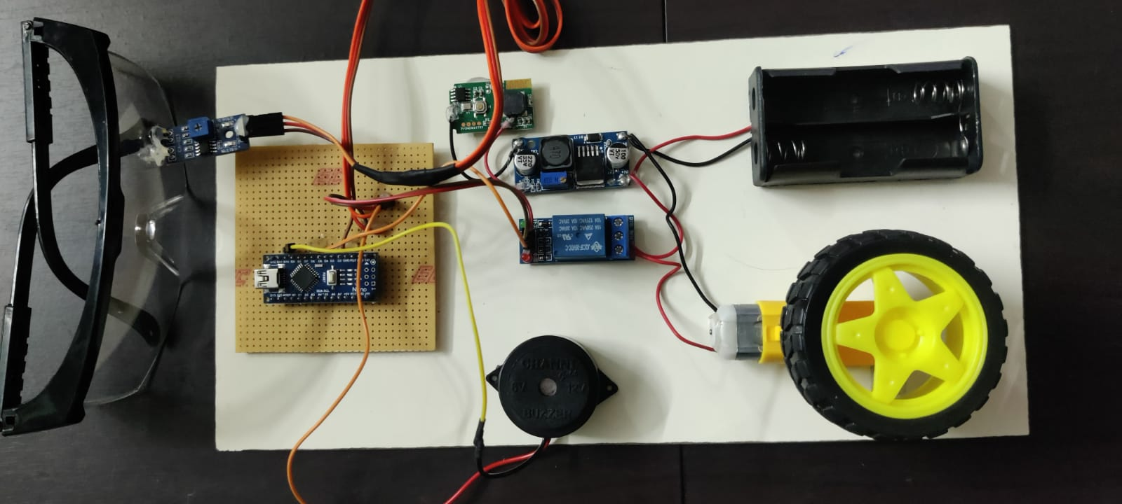
Implemented circuit

Slide 11
HARDWARE PROGRAMMING
The eye-blink sensor serves as a critical input component, detecting the driver's eye movements to gauge their alertness level. It is connected to the Arduino Nano microcontroller using shielded cables or wires to minimize interference and ensure reliable data transmission.
The Arduino Nano, being the central processing unit of the system, requires a stable power source for continuous operation. It can be powered via the vehicle's electrical system or an external power source, such as a dedicated power supply unit that is a battery pack.This ensures uninterrupted functionality of the monitoring system, even during vehicle operation.
The relay acts as a switch to control external devices based on input from the Arduino Nano. It is connected to the microcontroller using digital output pins, allowing the Arduino to trigger specific actions, such as activating alerts or initiating emergency protocols, based on the detected driver behavior.
The buzzer and GPS module serve as output components in the driver monitoring system, providing audible alerts and location tracking, respectively. The buzzer is connected to the system to emit warning signals in response to detected fatigue or hazardous driving behavior. Meanwhile, the GPS module is integrated to track the vehicle's location in real-time, enabling additional functionalities such as geo-fencing and route optimization
A battery pack is essential for providing backup power to the monitoring system, ensuring its functionality even in the absence of a stable power supply. The battery pack is connected to the system components using wired connections, offering a reliable power source for extended periods, particularly in scenarios where the vehicle's electrical system is unavailable or compromised.

Slide 12
SOFTWARE PROGRAMMING
The software programming aspect of the Smart Driver Monitoring System is crucial for controlling the behavior of the system, processing sensor data, and facilitating communication with external devices or servers. The code written for the Arduino Nano microcontroller is responsible for interpreting inputs from the eye-blink sensor, analyzing the data to determine the driver's fatigue level, and triggering appropriate actions such as activating alerts or interfacing with the vehicle's systems.
Additionally, algorithms are implemented to ensure accurate data processing and decision-making, enabling the system to respond effectively to varying driving conditions. User interfaces may also be developed to provide real-time monitoring and control capabilities, allowing users to interact with the system and access relevant information about the driver's status.The defined pin mappings for the eye-blink sensor,buzzer and relay module. These constants are used throughout the code to refer to specific pins on the Arduino board.
Here, the parameters defined such as eye-blinking and the delay between loop iterations. These parameters can be adjusted as needed to suit the requirements of the system.In the setup function, the serial communication is initialized at a baud rate of 9600.The pinMode function is used to configure the buzzer and motor pins as outputs and the sensor pins as input.Initially the motor pin is set to HIGH which indicates the motor is off.The loop function is where the main logic of the Driver Monitoring System is implemented.In the loop function, the digital state of the sensor pin is read and stored in the Status variable.

Slide 13
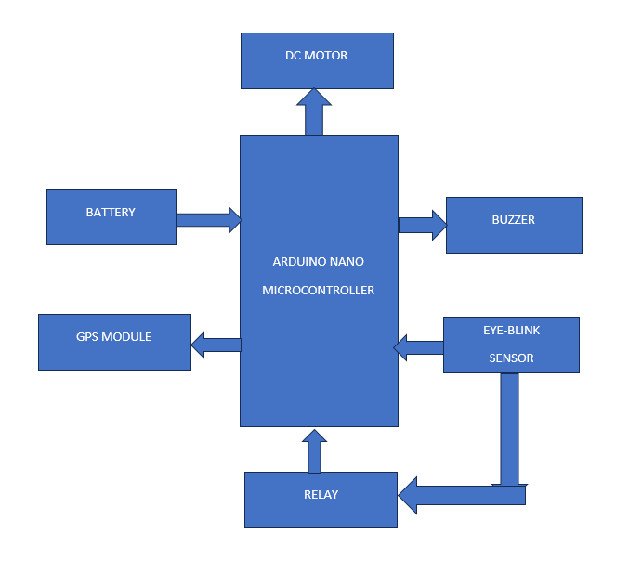
BLOCK DIAGRAM

Slide 14
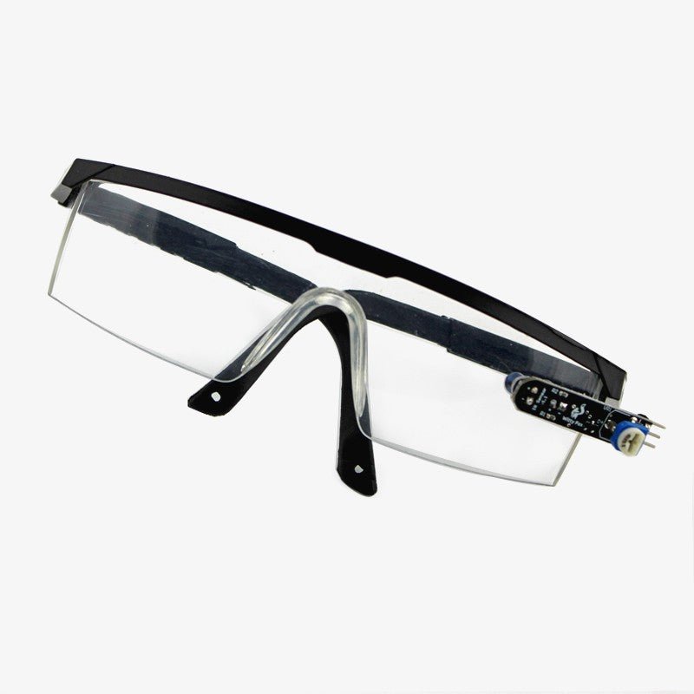
COMPONENTS
1.EYE BLINK SENSOR
Description: An eye-blink sensor, also known as an eye-tracking device, is a specialized sensor that detects and measures the movements of the eyelids and eyes. It typically utilizes infrared light or similar technology to track changes in the reflectivity or position of the eyes.
Application: In this project, the eye-blink sensor serves as the primary input device for monitoring the driver's state of alertness. By continuously analyzing the driver's eyelid movements and blink patterns, the sensor can detect signs of drowsiness or fatigue.
Installation: The eye-blink sensor is typically installed within the dashboard area of the vehicle, positioned to have a clear line of sight to the driver's eyes. It may be mounted using adhesive or screws, with care taken to ensure proper alignment and calibration for accurate detection.

Slide 15
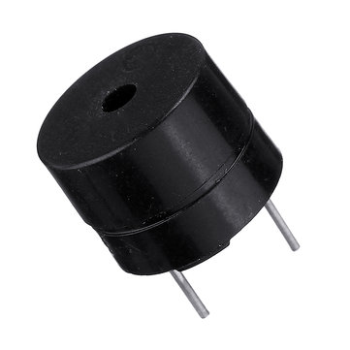
2. BUZZER:
Description: A buzzer is an electromechanical device that produces sound when an electrical current is passed through it. It typically consists of a coil and a vibrating diaphragm that generates audible vibrations.
Application: In this project, the buzzer serves as an alert mechanism to notify the driver when signs of drowsiness are detected. It emits a distinctive sound pattern, such as a series of beeps or tones, to grab the driver's attention and prompt them to take corrective action.
Installation: The buzzer is typically installed within the dashboard area or near the driver's seat, where it can be easily heard. It may be connected to the Arduino Nano or another control unit using electrical wiring, with proper insulation and grounding to prevent interference or electrical hazards.

Slide 16
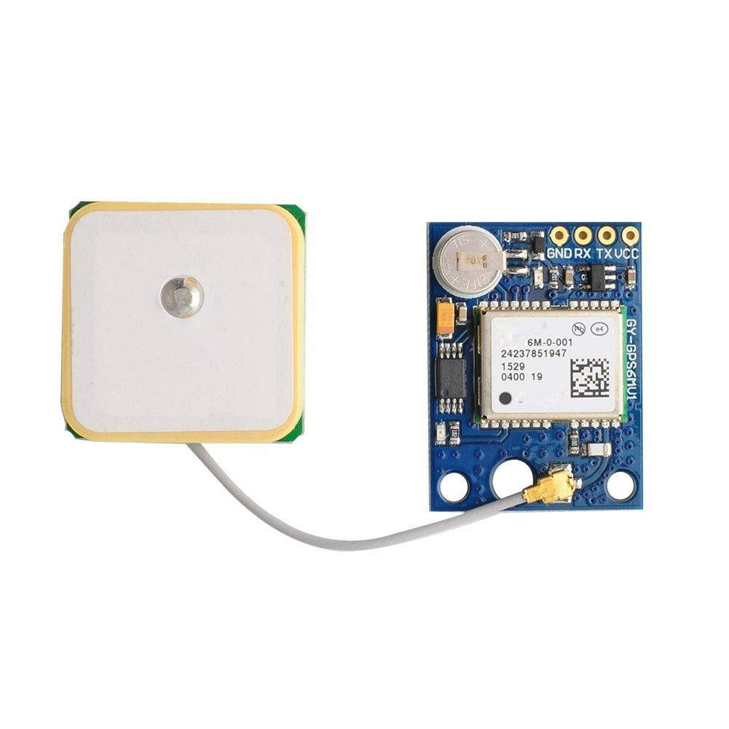
3.GPS MODULE:
Description: A GPS module is a device that receives signals from global positioning system (GPS) satellites to determine its location on the Earth's surface. It typically consists of a receiver chip, antenna, and processing circuitry.
Application: In this project, the GPS module is used to transmit the vehicle's location to a predefined recipient in real-time. It provides crucial information for prompt assistance and intervention in emergency situations, such as accidents or breakdowns.
Installation: The GPS module is typically installed within the vehicle's electronics system, either as a standalone unit or integrated into a larger control unit. It may require an external antenna for optimal signal reception, with care taken to position it away from obstructions that could interfere with satellite communication.

Slide 17
SYSTEM IMPLEMENTATION
The eye-blink sensor serves as a critical input component, detecting the driver's eye movements to gauge their alertness level. It is connected to the Arduino Nano microcontroller using shielded cables or wires to minimize interference and ensure reliable data transmission. The sensor's output signals are processed by the Arduino Nano, which analyzes the frequency and duration of blinks to determine the driver's fatigue level.
The Arduino Nano, being the central processing unit of the system, requires a stable power source for continuous operation. It can be powered via the vehicle's electrical system or an external power source, such as a dedicated power supply unit that is a battery pack.This ensures uninterrupted functionality of the monitoring system, even during vehicle operation.
The relay acts as a switch to control external devices based on input from the Arduino Nano. It is connected to the microcontroller using digital output pins, allowing the Arduino to trigger specific actions, such as activating alerts or initiating emergency protocols, based on the detected driver behavior.

Slide 18
RESULTS AND DISCUSSION
The project outlined presents a comprehensive and proactive solution to address the critical issue of driver drowsiness on our roads. By integrating advanced sensor technologies, microcontroller-based control systems, and intelligent alert mechanisms, the proposed system aims to detect and mitigate the risks associated with driver fatigue in real-time.
Central to its functionality is the utilization of an eye-blink sensor, which continuously monitors eyelid movement and blink frequency to identify patterns indicative of drowsiness. Upon detection, the system activates alert mechanisms such as a buzzer to warn the driver and a relay to safely stop the vehicle, thereby preventing potential accidents.
Furthermore, the integration of a GPS module enables the transmission of the vehicle's location to relevant authorities, facilitating prompt assistance and intervention in emergency situations. This combination of hardware and software components, coupled with rigorous testing in real-world driving conditions, demonstrates a commitment to enhancing road safety and preventing injuries. By addressing the root causes of accidents related to driver fatigue, the project aims to make a significant contribution to saving lives and fostering safer road environments for all users.

Slide 19
CONCLUSION
In conclusion, the proposed system presents a comprehensive solution to address the critical issue of driver drowsiness, a significant contributor to road accidents worldwide. By leveraging advanced sensor technologies and microcontroller-based control systems, we have developed an intelligent system capable of detecting and mitigating the risks associated with driver fatigue in real-time.The integration of an eye-blink sensor, buzzer, relay, GPS module, and Arduino Nano forms the foundation of our driver drowsiness detection system.
Through extensive testing and evaluation, we have demonstrated the effectiveness, reliability, and practicality of the proposed solution in detecting signs of driver drowsiness and initiating appropriate safety measures to prevent potential accidents.The project underscores the importance of proactive safety measures in enhancing road safety and reducing the incidence of accidents caused by driver fatigue. By cutting off the motor and bringing the vehicle to a controlled stop upon detecting signs of drowsiness, our system has the potential to save lives and prevent injuries on our roads.
However, while the project represents a significant step forward in addressing the issue of driver drowsiness, there are opportunities for further enhancement and refinement to improve the system's performance and usability in real-world driving scenarios.Enhancing the user interface to make it more intuitive and user-friendly could encourage wider adoption of the system among drivers.

Slide 20
FUTURE WORK
Algorithm Optimization: Further refinement of the drowsiness detection algorithm can improve the system's accuracy and responsiveness in detecting subtle signs of driver fatigue.
Integration of Machine Learning: Incorporating machine learning techniques can enable the system to adapt and learn from real-time data, enhancing its ability to accurately identify drowsiness patterns specific to individual drivers.
Enhanced User Interface: Developing a user-friendly interface for drivers to interact with the system and receive timely alerts and notifications can improve user acceptance and engagement.
Integration with Vehicle Control Systems: Exploring integration possibilities with existing vehicle control systems can enhance the seamless integration and interoperability of the drowsiness detection system with different vehicle models and makes.
Field Testing and Validation: Conducting extensive field testing and validation in diverse driving conditions and environments can provide valuable insights into the system's performance and reliability in real-world scenarios.
Biometric Sensors Integration : Exploring the integration of additional biometric sensors, such as heart rate monitors or EEG sensors, can provide supplementary data for more robust drowsiness detection. By analyzing multiple physiological signals, the system can enhance its accuracy in identifying fatigue-related patterns.
Multi-Modal Alerts : Investigating the use of multi-modal alerts, including auditory, visual, and haptic feedback, can cater to different driver preferences and environmental conditions. Customizable alert profiles based on driver preferences and situational contexts can further improve the effectiveness of alert notifications.

Slide 21
REFERENCE
[1] A. Vijay., Intelligent Driver Monitoring System for Safe Driving.,2023 IEEE International Conference on Electrical Systems for Aircraft, Railway, Ship Propulsion and Road Vehicles & International Transportation Electrification Conference (ESARS-ITEC), Venice, Italy, 2023.
[2] D. Varadam and K. V. Ganesh.,Design and Development of Smart Driver Safety System using the Behavioural and Physiological Data Approach.,2021 IEEE International Conference on Mobile Networks and Wireless Communications (ICMNWC), Tumkur, Karnataka, India, 2021.
[3] S. Jha, M. F. Marzban, T. Hu, M. H. Mahmoud, N. Al-Dhahir and C. Busso.,The Multimodal Driver Monitoring Database: A Naturalistic Corpus to Study Driver Attention., in IEEE Transactions on Intelligent Transportation Systems, vol. 23, no. 8, pp. 10736-10752, Aug. 2022.
[4] S. Yaqoob, G. Morabito, S. Cafiso, G. Pappalardo and A. Ullah.,AI-Driven Driver Behavior Assessment Through Vehicle and Health Monitoring for Safe Driving—A Survey.,in IEEE Access, vol. 12, pp. 48044-48056, 2024.
[5] A. Gharamohammadi, A. Khajepour and G. Shaker.,In-Vehicle Monitoring by Radar: A Review., in IEEE Sensors Journal, vol. 23, no. 21, pp. 25650-25672, 1 Nov.1, 2023.
[6] M. A. Farooq, W. Shariff, D. O’callaghan, A. Merla and P. Corcoran.,On the Role of Thermal Imaging in Automotive Applications: A Critical Review.,in IEEE Access, vol. 11, pp. 25152-25173, 2023.
[7] Whui Kim ,Youl-Kyeong Lee, Woo-Sung Jung Daeseung Yoo ,Do-Hyun Kim, and Kang-Hyun Jo, An Adaptive Batch-Image Based Driver Status Monitoring System on a Lightweight GPU-Equipped SBC ,In IEEE journals current version November 24, 2020.

